Slide 1
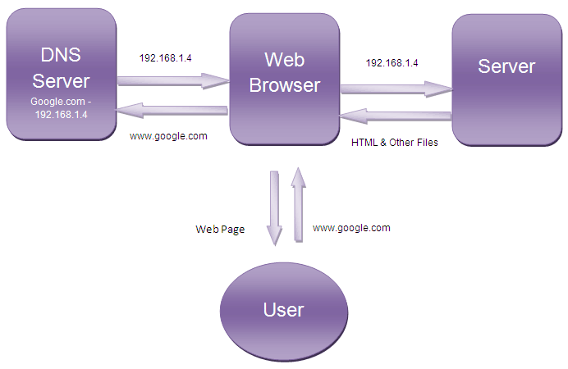
How does the web work

Slide 2
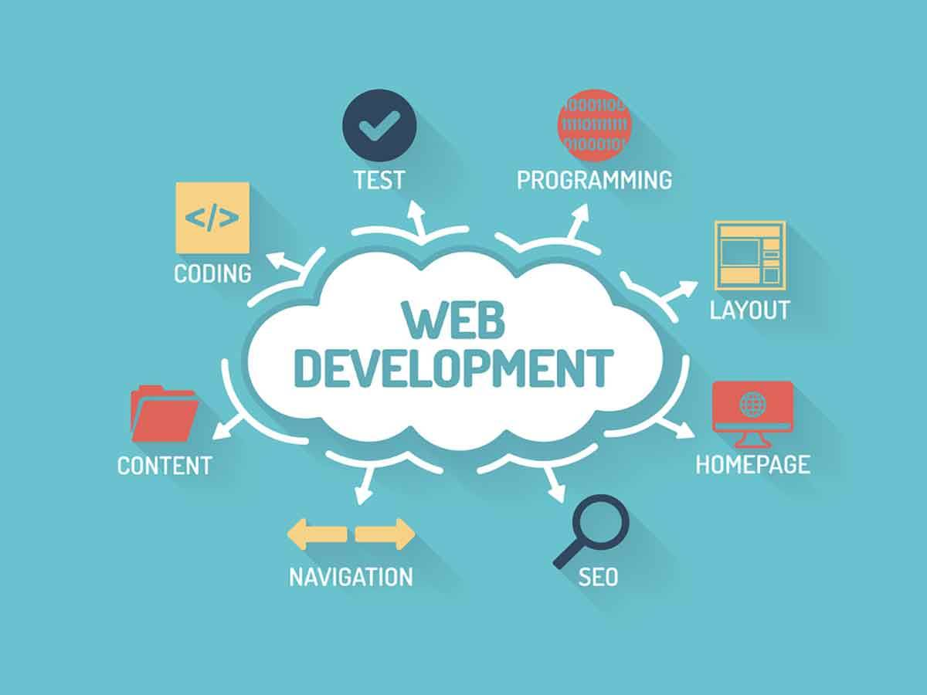
What do you need to be a web developer?
To become a Web Developer, you should have an understanding of :
HTML
CSS
JavaScript
Choose a development specialization
Learn key programming languages for web development
Work on projects to develop your Web Developer skills
Build a web development portfolio

Slide 3
Why did you choose to learn web development?
Learning programming and web development languages ​​today opens many doors in our daily lives.
It allows us to understand the world of tomorrow.
Web development is first of all rewarding on a personal level.
With your training I will have a lot of chances and skills in this area and as a result of the adventures for a good position.

